Slide 1
Life Expectancy
Digicap Data Science Team (EDA Group)

Slide 2
The Team
Team Lead
Wiafe Kwabena
Dep Team Lead
Benjamin Obeng
Health Expert
Robert Afotey
Data Analyst
Joseph A.A. Biasiako
Data Scientist
Elikiplim Gamor
20XX
Supervisor-Josephine A. Bekoe

Slide 3
The Overview
20XX
About the Data

Slide 4
Acknowledgements
The data was collected from WHO and United Nations.
About this file
the life expectancy dataset was from WHO ..The dataset contains information from the years 2000 -2015 for 193 Countries. There were no errors in the relation to the data....Missing data were found to be from less known countries like Cabo Verde , Togo ,Vanuatu, Tonga etc.
Finding all data for these countries were difficult and hence it was decided to exclude these countries from the final model dataset.
The final merged file contains 22 columns and 2938 rows which meant 20 predicting variables...
All predicting variables was divided into broad categories like immunization related factors , mortality factors , economical and social factors

Slide 5
Hypothesis
20XX
High Level of Education increases life Expectancy
High Income Composition rate increases Life Expectancy
Countries with stable economic(GDP) have higher life Expectancy
Developing Countries are infected by most Diseases such as polio, Measles etc.,
5) Developing Countries with Population have High infant rate

Slide 6
Questions
20XX
Inspiration
The data-set aims to answer the following key questions:
Should a country having a lower life expectancy value(<65) increase its healthcare expenditure in order to improve its average lifespan?
How does GDP affect life expectancy?
Does Life Expectancy have positive or negative correlation with income composition of resources?
What is the impact of schooling on the lifespan of humans?

Slide 7
Tools for the Data Analysis
20XX
Microsoft Excel
Microsoft Power BI
Jupyter Notebook and Python Libraries
Pandas
Numpy
Matplotlib

Slide 8
Data Cleaning
20XX
We describe the dataset
We checked and rename the columns for easy usage
We check for null values
Checking of duplicated value in the Dataset
We identify the outliers
Dropping the BMI column because is has
unrealistic value

Slide 9
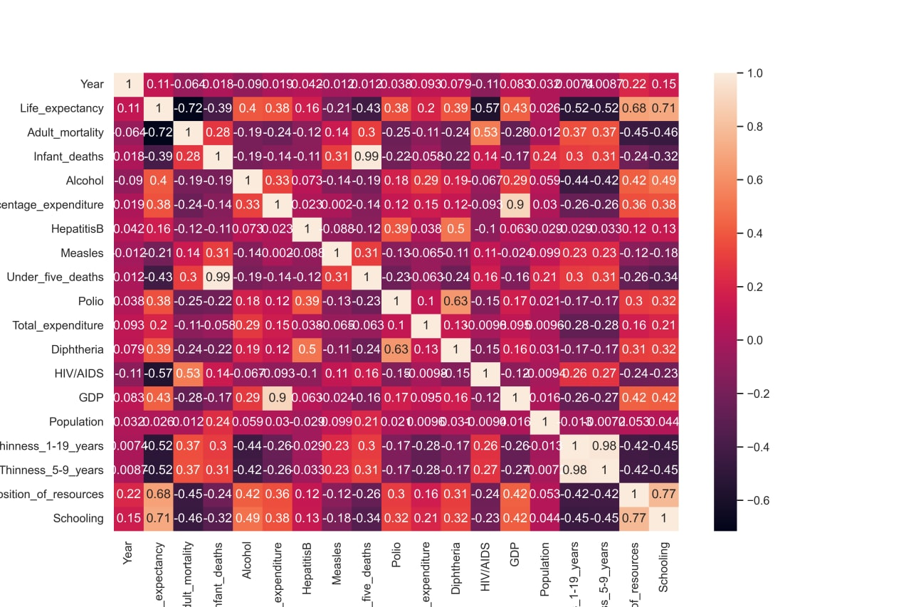
Data Visualization
20XX
Correlation
The features with correlation value near to 1 have strong +positive correlation and near to -1 have strong -negative correlation.

Slide 10
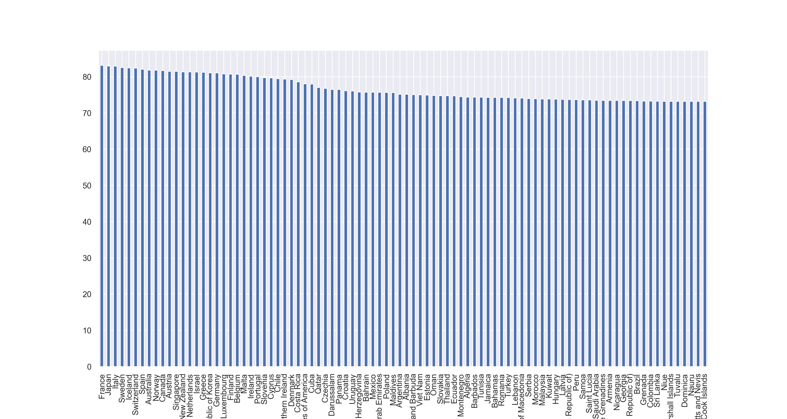
20XX
Countries with the Highest Life
Expectancy
France, Japan, Italy and Sweden has the highest Life
Expectancy

Slide 11
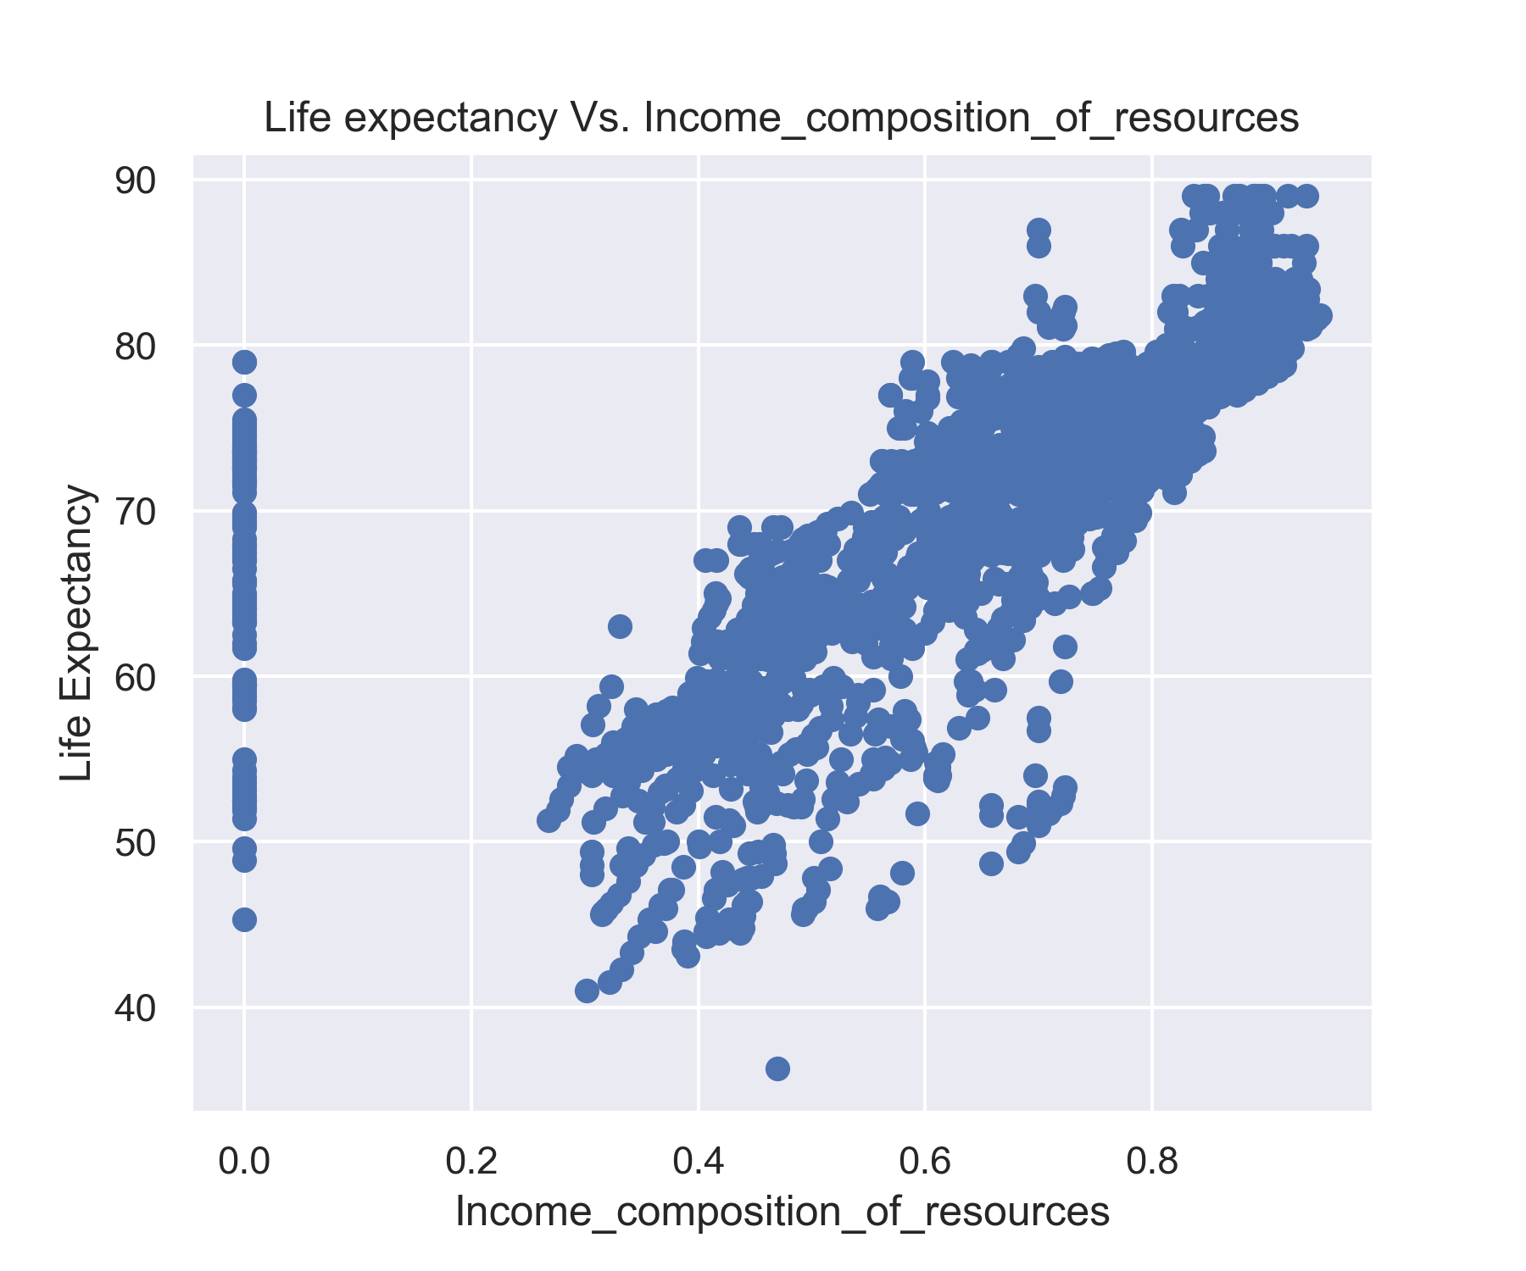
20XX
Life Expectancy and Income Composition
Income Composition and Life Expectancy have a Correlation value of 0.83 this means the higher income composition of a country the higher it Life Expectancy

Slide 12
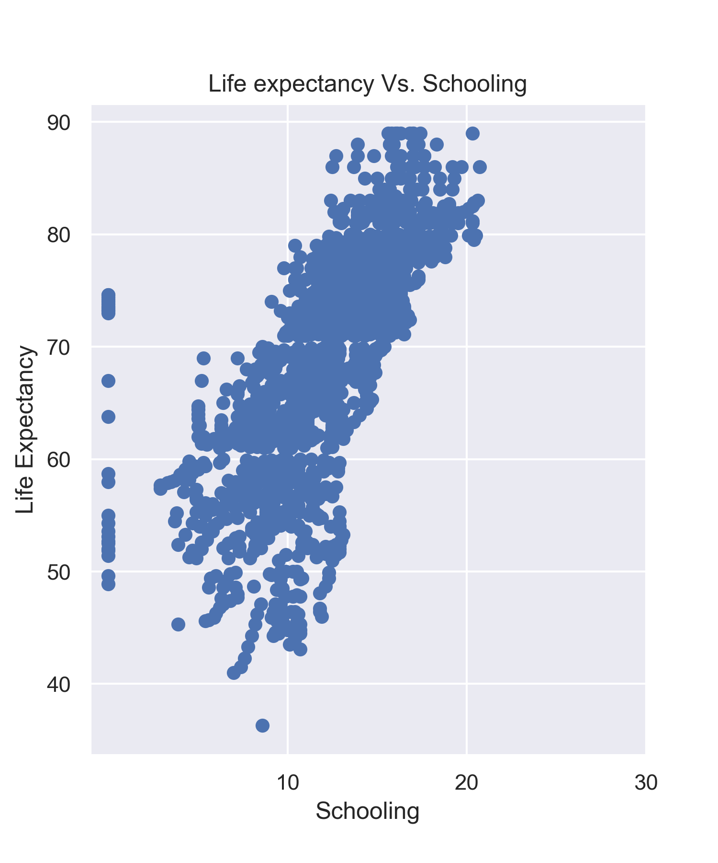
20XX
LIFE EXPECTANCY AND SCHOOLING
Schooling and life Expectancy have a correlation value of 0.75 this mean that as schooling goes up Life Expectancy increases as well.

Slide 13
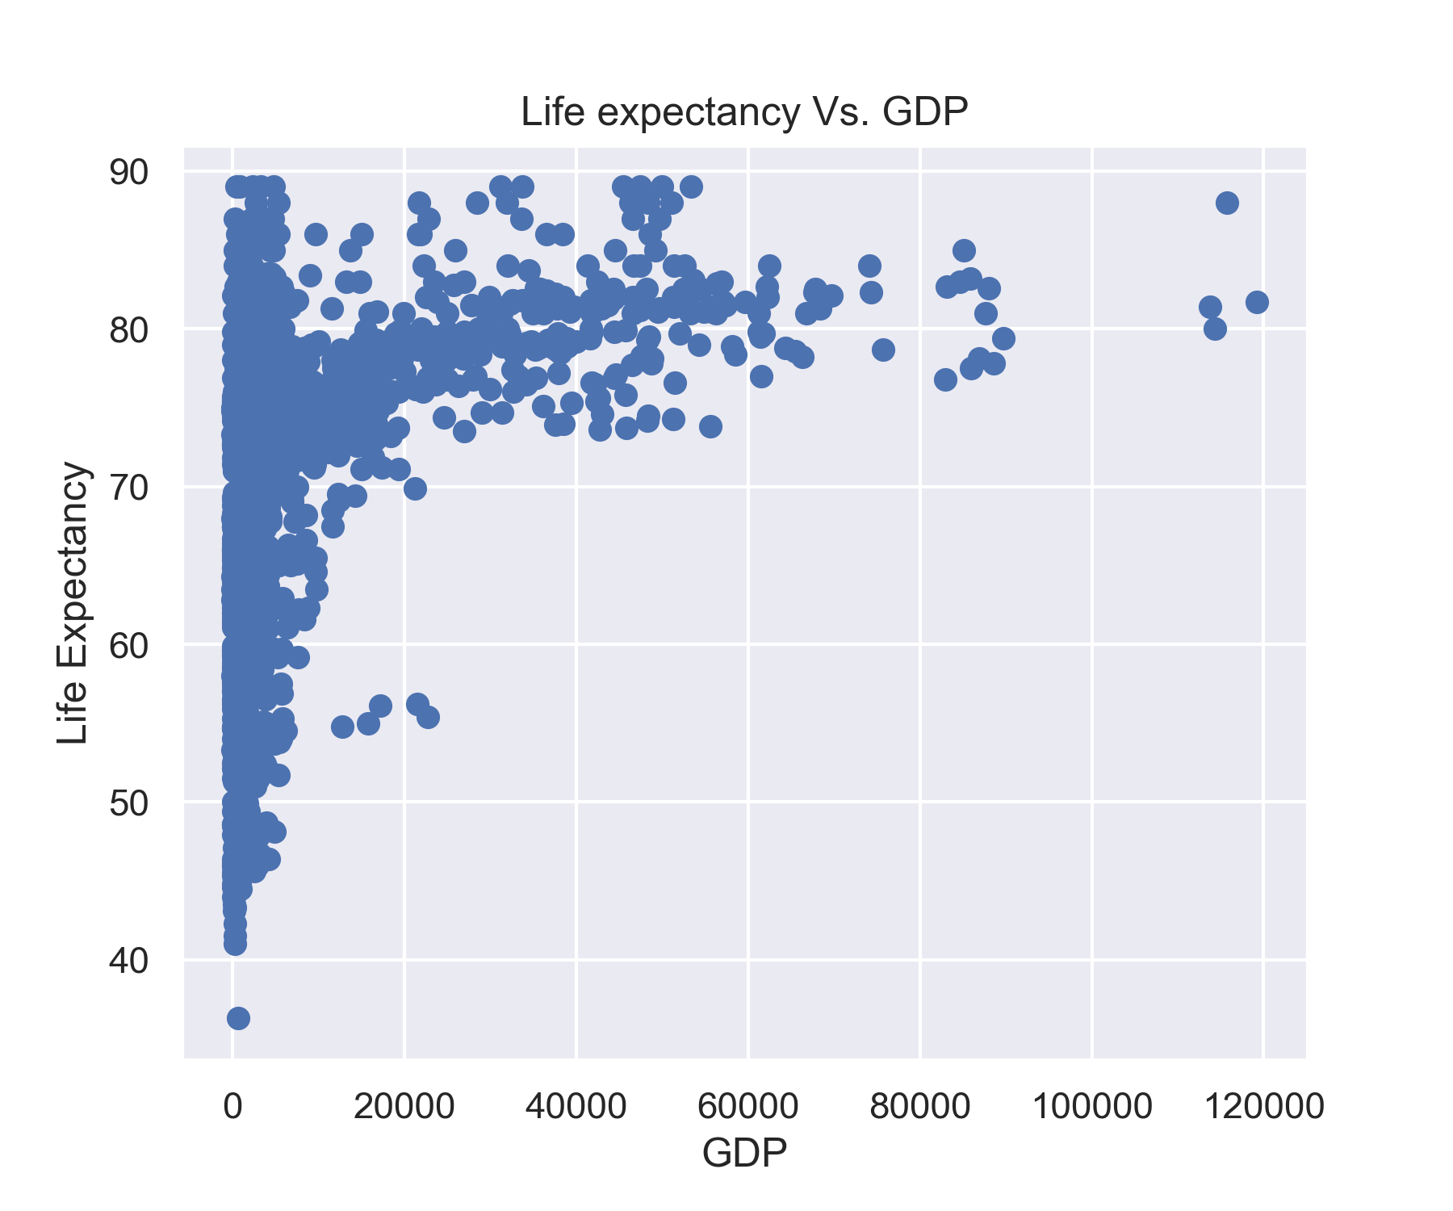
20XX
LIFE EXPECTANCY AND GDP
GDP and life expectancy have a correlation value 0.43 this means that as GDP goes up so does the Life Expectancy.

Slide 14
Conclusion
20XX
This report supported most of the assumptions made in the Hypothesis. Life Expectancy increases GDP, Schooling and Income Composition increases.
From a Social Perspective, Life Expectancy can be an indicator of the quality of life in a Country.
Law makers and Leaders in every Country should be making evidence based decisions to improve their societies .

Slide 15
THANK YOU!

